Slide 1


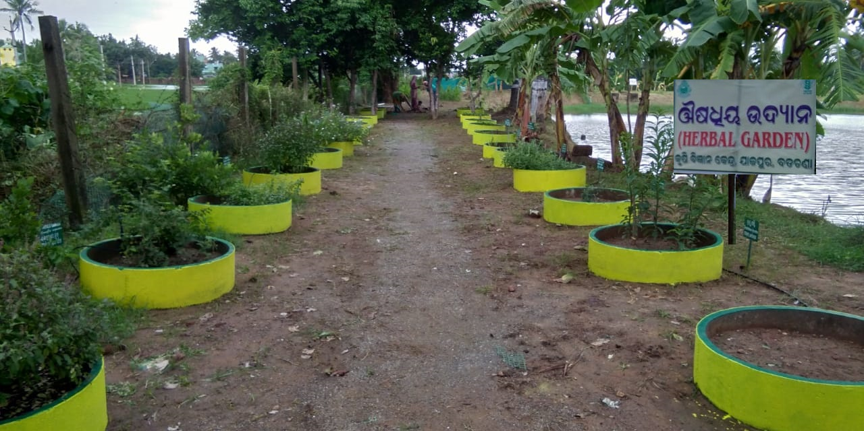
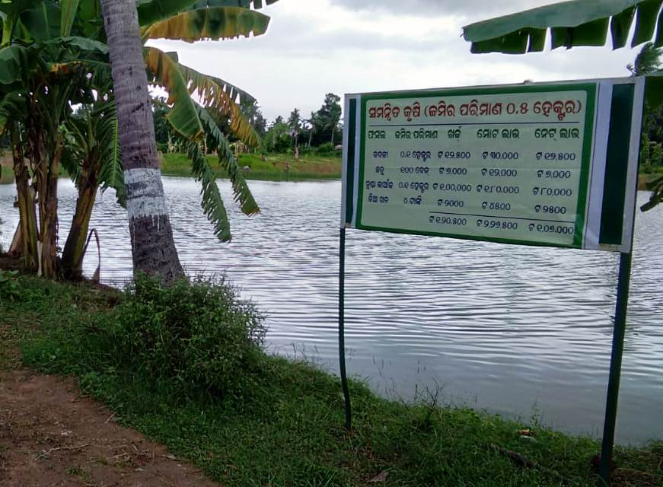
ACTION PLAN
2020-21
KRISHI VIGYAN KENDRA, JAJPUR
ODISHA UNIVERSITY OF AGRICULTURE & TECHNOLOGY BHUBANESWAR

Slide 2
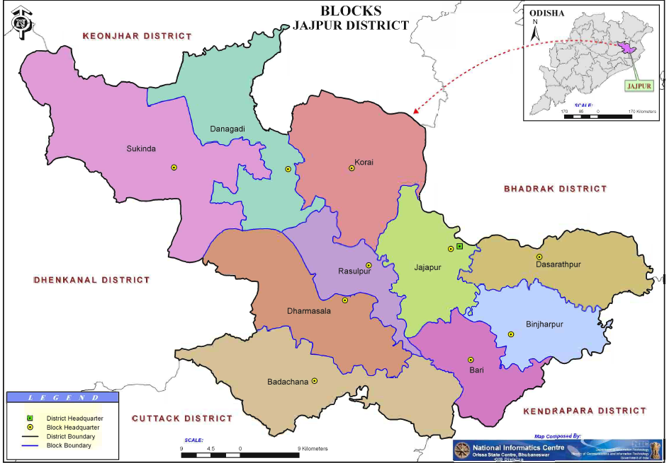
DISTRICT MAP

Slide 3
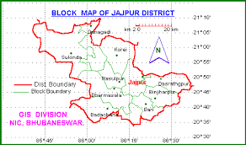
Basic information : AES features
Name of KVK : Jajpur
Name of Agro climatic zone: North Eastern Coastal plain Zone & Mid central table land
Details of AES
Sl. No. | Name of AES | Area(ha) | Blocks covered | Village | Major crops
1 | Low lying flood prone | 55295 | Jajpur, Bari, Dashrathpur, Binjharpur | Khadipada | Rice-blackgram/greengram/vegetable
2 | Saline Soil | 18419 | Dashrathpur, Binjharpur | Jari | Rice- blackgram
3 | Red Laterite Rainfed | 27426 | Korei | - | Rice-blackgram
4 | Alluvial Rainfed | 129430 | Dharmasala, Rasulpur, Badachana, Danagadi | Choromuha Dihakuransa | Rice-Groundnut/blackgram/greengram/vegetable
5 | River vally alluvial medium rainfall | 17790 | Sukinda | - | Rice-pulse/groundnut
6 | Light laterite (High rainfall) | 41540 | Sukinda | Sunsilo | Rice

Slide 4
ADOPTED VILLAGES
Name of Block | Name of GP | Name of village
Rasulpur | Rahamba | Dihakuransa
Dharmasala | Choromuha | Choromuha
Jajpur | Bhubaneswarpur | Khadipada
Sukinda | Sunsilo | Sunsilo
Binjharpur | Jari | Jari

Slide 5
BASIC INFORMATION
Geographical area : 2,89,900 ha
Gross cropped area : 2,50,602 ha
Total cultivated area : 1,45,450 ha
Upland : 51754ha (36%)
Medium land : 48036 ha (33%)
Low land : 45660 ha (31%)
Net sown area : 1,37,000 ha
Total Paddy area : 1,17,000 ha
Cropping intensity : 169.28 %
Soil type : Alluvial soil, red laterite soil,saline soil
No of GP :280
No of village :1972
No of Agriculture laboures :81,907
No of non Agriculture laboures:2,45,421

Slide 6
BASIC INFORMATION
Irrigation potential
Kharif : 47%
Rabi : 27%
Fertilizer consumption
- Kharif : 111.2 kg/ha
- Rabi : 56.86 kg/ha
- Average : 84.03 kg/ha
- Humidity : 84-87 %
- Temperature : 14 ⁰C and 43 ⁰ C
-Annual Rain fall :1559.9mm
- PH range :5.2 to 7.4

Slide 7
MAJOR CROPS AND COMMODITIES
Name of Crop | Kharif | Rabi | Avg. Productivity
 | Area (ha) | Area (ha) | q/ha
Paddy | 1,12,800 | 4200 | 25.43
Groundnut | 994 | 32006 | 15.95
Greengram | - | 25000 | 3.15
Blackgram | 1720 | 21000 | 3.05
Sugarcane | - | 2000 | 642.50
Mustard | - | 3000 | 3.78
Jute | 1000 | - | 20.03
Total vegetable | 19452 | 20700 | 138.5
Total spice | 1250 | 4000 | 13.35

Slide 8
Name of commodity | No | Total Production /year
Dairy | 5,03,505(cattle) 4386 (buffalo) | 1,39,613 lakh lit.
Goatary | 1,98,058 | 53,377 ton
Poultry | 2,05,474 | 49,314 ton
Mushroom | 600 bed/day | 200 ton
Fisheries | 2923 | 9840 MT

Slide 9
THRUST AREAS OF KVK
Crop
diversification
Integrated Pest ,Disease
& weed management
Mushroom cultivation
Varietal substitution
Backyard poultry
INM in field crops, Fruits
& Vegetable
Pisciculture & Diary
KVK
Honey bee
rearing
Farm
mechanization
Marketing
awareness

Slide 10
OFT No. 1 | Assessment of Integrated Weed Management in Maize
Season & Year | kharif, 2020 | No. of Trials & villages |  | 07 (Sansilo, Patrapada,)
Crop / commodity | Maize | Farming Situation |  | Season-Kharif, 2020 land type- Upland Irrigation- Rainfed Cropping system-
Problem diagnosed (one or many) | Heavy weed infestation | Spread and intensity of problem |  | 1560 ha
FP | Weeding through earthling up at 15 DAS + Use of herbicide 2-4-D @500g/ha at 30 DAS
T O₁ | Weeding through earthling up at 15 DAS + Use of herbicide Atrazine 50% WP @ 2kg/ha at 20 DAS |  |  |  | Source : OUAT 2014
T O ₂ | Weeding through earthling up at 15 DAS +Use of herbicide Tembotrione 42% SC @287.5 ml/ha at 20 DAS |  |  |  | Source:-OUAT 2019
Characteristics of technology | TO₁- Atrazine controls effectively grasses, edges and broad leaves weeds
 | TO₂- Tembotrione controls effectively grasses, edges and broad leaves weeds
Observation Parameters | Weed flora count, No of cobs/plant,cob weight(g.), 1000 grain wt |  | Performance Indicator |  |  | Weed control efficiency Yield (q/ha), B:C ratio,
farmers feedback
Scientist(s) to be involved | L. K. Mohanty, Scientist (Agronomy)

Slide 11
OFT No. 2 | Assessment of weed management in Sugarcane
Season & Year | Rabi, 2020-21 | No. of Trials & villages | 07 (Dihakuransa, Damodarpur)
Crop / commodity | Sugarcane | Farming Situation | Season-rabi land type-medium land Irrigation-Irrigated Cropping system-Rice -Pulse
Problem diagnosed (one or many) | Heavy weed infestation in sugarcane | Spread and intensity of problem | Problem coverage-1870 ha extent of production loss- 30%
FP | Manual weeding at 30 DAP
T O₁ | Use of herbicide Atrazine 50% WP @ 2kg/ha at 20 DAP |  |  | Source : OUAT 2011
T O ₂ | Use of herbicide metribuzine @2 DAP and 2-4-D 0.5kg/ha at 90 DAP |  |  | Source :OUAT 2012
Characteristics of technology | TO₁- Atrazine controls effectively grasses, edges and broad leaf weeds
 | TO₂- Metribuzine controls effectively grasses, sedges and broad leaf weeds
Observation Parameters | weed count, WCE, Cane weight, No. of tillers/hill | Performance Indicator |  | Weed control efficiency Yield (q/ha), B:C ratio,
farmers feedback
Scientist(s) to be involved | L. K. Mohanty, Scientist (Agronomy)

Slide 12
OFT No. 3 | Assessment of Sulphur and Boron for higher yield in cabbage
Season & Year | rabi, 2019-20 (Year-II) | No. of Trials & villages |  | 07 (Dihakuransh,Rasulpur)
Crop / commodity | cabbage | Farming Situation |  | Season-rabi Medium land Irrigated Cropping system –Rice-vegetable
Problem diagnosed (one or many) | Low quality and yield due to secondary and micro nutrient deficiency | Spread and intensity of problem |  | Problem coverage-1500 ha
FP | NPK as basal application(110-50-40 kg/ha)
T O₁ | STBF (NPK: 120-60-60)+ Sulphur @30 kg ha +1 kg Boron as basal application |  |  | Source- AICRP on Micronutrient and pollutant, OUAT, BBSR, Odisha, 2016
T O ₂ | STBF (NPK) +1 kg Boron as basal application
Characteristics of technology | T O₁₋ Along with Sulphur @ 30kg/ha. , micronutrient Boron is essential for quality curd and major nutrient NPK
 | T O ₂- Boron which has effect on curd quality . Boron 1kg/ha in the form of Borax
Observation Parameters | Curd wt. (g.), no. of days harvesting |  | Performance Indicator |  | Yield (q/ha), B:C ratio
farmers feedback
Scientist(s) to be involved | Mr. S. Dash, Scientist (Soil Sc.)

Slide 13
OFT No. 4 | Assessment of consortia of micro organism (Azotobactor + Azospinillum +PSB) in pointed gourd
Season & Year | Rabi, 2020-21(Year-II) | No. of Trials & villages | 07 (Dihakuransh,Rambhadeiur)
Crop / commodity | Pointed gourd | Farming Situation | Season-rabi Medium land Irrigated, Cropping system – Rice-vegetable
Problem diagnosed (one or many) | Low yield due to low beneficial microbial population | Spread and intensity of problem | Spread & intensity of problem- 1 ha
FP | Only NPK (100-50-60 kg/ha.)
T O₁ | STBF(120-80-80)- + 100 kg of FYM & inoculated with 4kg Azotobactor, Azospirillum & PSB+ |  |  | Source :AINP on Biodiversity & biofertilizer
T O ₂ | STBF + 5 kg lime mixed with 100 kg of FYM & inoculated with 4kg Azotobactor, Azospirillum & PSB |  |  | Source :AINP on Biodiversity & biofertilizer
Characteristics of technology | T O₁- Application of STBF(120-80-80) correctly the deficiency of essential nutrients
 | T O ₂- Application of bio-fertilizer increases yield, quality of produce & fetches good market price
Observation Parameters | Fruit size, No. of fruits /plant, Fruit weight(g.) |  | Performance Indicator |  | Yield (q/ha), B:C ratio,
farmers feedback
Scientist(s) to be involved | Mr. S. Dash, Scientist (Soil Sc.)

Slide 14
OFT No. 5 | Assessment of potato varieties
Season & Year | Rabi, 2020-21 (Year-I) | No. of Trials & villages |  | 07(Dihakuransh, Choromuha, Arakhpur)
Crop / commodity | Potato | Farming Situation |  | Season-rabi Medium land, Irrigated, Cropping system –Vegetable-vegetable
Problem diagnosed (one or many) | Low yield due to late planting ,temperature fluctuation during tuberization | Spread and intensity of problem |  | Problem coverage-600ha extent of production loss (20%)
FP | Kufri jyoti
T O₁ | Kufri Himalini |  |  |  |  | Source : CPRI, Simla, 2010
T O ₂ | Kufri Khyati
Characteristics of technology | TO1- Kufri Himalini (Medium size, oval oblong, white tuber with pale yellow flesh, better keeping quality, resistant to late blight, Avg. yield- 300 350 qtl/ha)
 | TO2- Kufri Khyati (High yielding, early maturing, tubers are ovoid, cremish, white with medium deep eyes, Avg. yield- 250-300 qtl/ha, duration 70-75 days).
Observation Parameters | No. of tubers/plant, individual tuber wt., diameter of tuber |  | Performance Indicator |  | , Yield(qt/ha), B:C ratio
farmers feedback
Scientist(s) to be involved | Mrs. B. Mishra, Scientist (Hort.)

Slide 15
OFT No. 6 | Assessment of different trellis in bittergourd for higher production
Season & Year | rabi, 2020-21 (Year-II) | No. of Trials & Vill | 07 (Dihakuransh,Haripur, Garwalnarsinghpur, Rambhadeipur)
Crop / commodity | Bittergourd | Farming Situation | Season-rabi Medium land, Irrigated, Cropping system –Rice-vegetable
Problem diagnosed (one or many) | High incidence of fruit rot due to ground trelling | Spread and intensity of problem | Problem coverage-400ha extent of production loss (30%)
FP | Ground trailing
T O₁ | Single trellis, one row trellis constructed with bamboo poles & GI wires, jute rope. |  |  |  |  | Source-CHES 2014
T O ₂ | Lean to type trellis – stakes are joined between two adjoining bed forming an A shaped structure horizontal stakes are installed at the top joining of all other beds . The stakes support the climbing vines. Strings are used to secure adjoining stakes. trellis height 2m.
Characteristics of technology | T O₁₋ minimize pest, disease, drudgery in bitter gourd
 | T O ₂₋ lean type trellis covered significantly higher fruit yield, lower fruit loss, lower pest population and disease due to ease in manual irrigation, fertilization, pest monitoring and weeding as compared to single trellis
Observation Parameters | Length of fruit, Wt. of fruit, incidence of fruit rot |  |  | Performance Indicator | Yield(qt/ha), B:C ratio
Scientist(s) to be involved | Mrs. B. Mishra, Scientist (Hort.)

Slide 16
OFT No. 7 | Assessment of different paddy threshers
Season & Year | Kharif, 2019 (Year-II) | No. of Trials & villages |  | 07 (Choromuha, Dihakuransa, Khadipada)
Crop / commodity | Paddy thresher | Farming Situation |  | Season-Kharif Rainfed medium land
Problem diagnosed (one or many) | High labour cost of threshing paddy | Spread and intensity of problem |  | Problem coverage- 50000 ha
FP | Power paddy thresher
T O₁ | To1- Tractor driven axialflow thresher |  |  |  | Source- AICRP on FIM, CAET, OUAT 2015-16
T O ₂ | To2- Tractor driven whole straw paddy thresher
Characteristics of technology | T O₁₋ Threshing capacity 8 qtl/hr.
 | TO₂- Threshing capacity 5 qtl/hr.
Observation Parameters | Threshing capacity (qtl/hr.), cost of threshing (Rs/qtl.), labour requirement (mandays/ha) |  | Performance Indicator |  | Yield , B:C ,
farmers feedback
Scientist(s) to be involved | Mrs. B. Mohanta, Scientist (Agril.Engg.)

Slide 17
OFT No. 8 | Assessment of groundnut threshers for stripping of groundnut
Season & Year | Rabi, 2020-21 (Year-I) | No. of Trials & villages |  |  | 07 (Dihakuransa, Bahabalpur, Block-Rasulpur)
Crop / commodity | Groundnut | Farming Situation |  |  | Season-Rabi Medium land, Irrigated, Cropping system –Rice-groundnut
Problem diagnosed (one or many) | High labour cost on manual stripping | Spread and intensity of problem |  |  | Problem coverage-25000ha
FP | Manual stripping
T O₁ | power operated groundnut thresher |  | AICRP on FIM,CAET,OUAT, 2015-16, ( Research activities during 2016-17: Transferable Technologies and Technical Programme
T O ₂ | tractor driven groundnut thresher
Characteristics of technology | T O₁₋ Actual field capacity: 200-300 kg/h ,No damage
 | T O ₂₋ Tractor operated Groundnut Thresher for different groundnut varieties-Threshing of groundnut pods can be done in the field itself without transporting to the threshing yard Capacity: 500-550 kg/h,Threshing efficiency – 85-90%
Observation Parameters | Stripping capacity (kg/h), labour required for stripping (man days/ha), stripping efficiency , % of damaged pods |  |  | Performance Indicator |  | cost of operation (Rs/ha), B:C
farmers feedback
Scientist(s) to be involved | Mrs. B. Mohanta, Scientist (Agril.Engg.)

Slide 18
OFT No. 9 | Assessment of different planting time for better market price of Cauliflower
Season & Year | Rabi, 2020-21 (Year-I) | No. of Trials & villages | 07 (dihakuransa,Dharmasala)
Crop / commodity | Cauliflower | Farming Situation | Season-rabi medium land, Irrigated, Cropping system –Rice-vegetable
Problem diagnosed (one or many) | Distress sale of Cauliflower in rabi season | Spread and intensity of problem | Problem coverage-800ha
FP | Farmers generally plant the seedling in the month of October
T O₁ | Planting of seedling 1 month before onset of normal planting period |  |  | source
T O ₂ | Planting of seedling 1 month after completion of normal planting period
Characteristics of technology | TO₁- Advancing of planting time* by 1 month to help in capturing higher market price in initial period
 | TO₂ Delaying of planting time* by 1 month to help in capturing higher market price
Observation Parameters | Head weight, Disease & pest incidence, Market price | Performance Indicator |  | Yield/ha, B:C ratio& Economics
farmers feedback
Scientist(s) to be involved | S.K.Panigrahi,Scientist (Agrik Extn.) and Mrs B.Mishra scientist (Horticulture)

Slide 19
FLD No. 1 | Demonstration on IWM for managing weeds during kharif in transplanted rice
Season & Year | Kharif, 2020 | No. of Demo | 5
Crop / commodity | Rice | Farming Situation | Irrigated, medium land,
Problem diagnosed | Heavy weed infestation in transplanted rice | Spread and intensity of problem | 60000ha
FP | Manual weeding at 30 DAT
Demo | Post emergence application of herbicide Penuxulam 93.75ml/ha at 12 DAT + HW at 30 DAT |  |  | Source : OUAT,2015
Details of the technology | Post emergence application of herbicide @ 93.75 ml/ha at 12 DAT
Observation Parameters | Weed flora count, No of tillers/hill,1000 grain wt |  | Performance Indicator |  | Weed control efficiency, Yield (q/ha), B:C ratio,
farmers feedback
Scientist(s) to be involved | Mr L. K. Mohanty, Scientist (Agronomy.)

Slide 20
FLD No. 2 | Demonstration on INM in maize under irrigated medium land situation
Season & Year | Kharif, 2020 | No. of Demo |  | 5
Crop / commodity | Maize | Farming Situation |  | Irrigated, medium land
Problem diagnosed | Poor plant growth and low cob weight due to low dose of fertiliser | Spread and intensity of problem |  | 1500 ha
FP | Lower dose of chemical fertilizer 70:30:30 NPK kg/ha
Demo | INM in maize under irrigated medium land situation |  |  | Source :RRTSS, Bhawanipatna, DOR,OUAT, 2017-18
Details of the technology | Application of N:P:K:B:Zn @ 150:75:60:1:5 kg ha-1 + Lime 0.1 LR + FYM @ 5 t ha
Observation Parameters | Plant ht,cob length and weight, Grain wt |  | Performance Indicator |  | Yield (q/ha), B:C ratio,
farmers feedback
Scientist(s) to be involved | Mr L. K. Mohanty, Scientist (Agronomy.)

Slide 21
FLD No. 3 | Demonstration on Integrated Weed Management in greengram
Season & Year | Rabi, 2020-21 | No. of Demo |  | 5
Crop / commodity | Greengram | Farming Situation |  | Irrigated, medium land
Problem diagnosed | Heavy weed infestation in greengram | Spread and intensity of problem |  | 20000 ha
FP | No use of herbicide
Demo | Use of herbicide Imazethapyr @750ml/ha at 20 DAS |  |  | Source : OUAT, 2015
Details of the technology | Post emergence application of herbicide Imazethapyr @750ml/ha 15DAS
Observation Parameters | No of pods/plant, No of grains /pod, weed count. |  | Performance Indicator |  | Weed control efficiency Yield (q/ha), B:C ratio
farmers feedback
Scientist(s) to be involved | Mr L. K. Mohanty, Scientist (Agronomy.)

Slide 22
FLD No. 4 | Demonstration on Integrated Nutrient Management in sugarcane for higher yield and profitability
Season & Year | Rabi, 2020-21 | No. of Demo | 5
Crop / commodity | Sugarcane | Farming Situation | Irrigated, medium land
Problem diagnosed | Poor tillering and low cane weight | Spread and intensity of problem | 1500 ha
FP | Improper dose of chemical fertilizer(130-40-40 NPK kg/ha) and no use of biofertiliser
Demo | Integrated Nutrient Management |  |  | Source : SLREC 2015
Details of the technology | Soil test based fertilizer application in sugarcane @ 315:100:60 kg N:P2O5:K20+60 kg elemental S/ha recorded highest cane yield of 81.44 t/ha and was most remunerative.
Observation Parameters | Cane length, cane wt |  | Performance Indicator |  | Yield (q/ha), B:C ratio,
farmers feedback
Scientist(s) to be involved | Mr L. K. Mohanty, Scientist (Agronomy.)

Slide 23
FLD No. 5 | Demonstration on Boron application in low land rice
Season & Year | Kharif, 2020 | No. of Demo |  |  | 5
Crop / commodity | Rice | Farming Situation |  |  | Irrigated, medium land,
Problem diagnosed | Low yield due to more chaffy grain in the panicle attributed by boron deficiency | Spread and intensity of problem |  |  | 22000 ha
FP | RDF (90-40-40 NPK kg/ha)
Demo | STBR NPK + foliar spray of 0.25% Borax at panicle initiation stage and at pre flowering stage |  |  | Source : AICRP on micronutrient, Bhubaneswar, Odisha, 2016
Details of the technology | Boron is an essential micronutrient , which is responsible for cell wall formation & stabilization, pollen germination & pollen tube growth, impart drought tolerance to plants. Application of STBR NPK as basal and two foliar spray of B as Borax at panicle initiation stage and at pre flowering stage help in high pollination & more filled grain. Also increases the Nitrogen use efficiency of the plant.
Observation Parameters | Initial & after harvest soil test value, No. of tiller/m^{2 ,} No. of filled grain/panicle, sterility %, |  | Performance Indicator |  |  | Yield (q/ha), B:C ratio,
farmers feedback
Scientist(s) to be involved | Mr S.Dash, Scientist (Soil Sc.)

Slide 24
FLD No. 6 | Demonstration on production technology of vermicompost using local available waste material.
Season & Year | Kharif, 2020 | No. of Demo |  |  | 5
Crop / commodity | vermicompost | Farming Situation
Problem diagnosed | Inadequate availability of FYM for crop and its low nutrient status | Spread and intensity of problem
FP | Farmyard manure
Demo | Composting cow dung and leafy materials in the ratio of 3:10 in the vermicompost polythene bag size of 8’x4’x2.5’ with release of earthworm (variety: Eisenia foetida) @1kg/qtl. of waste material. |  |  | Source : AINP on biodiversity and bio-fertilizer , OUAT, 2010
Details of the technology | Vermiculture is a process by which all type of degradable waste such as farm waste, kitchen waste, bio waste, livestock waste etc. are converted while passing through the worm gut to nutrient rich vermicompost.
Observation Parameters | Nutrient status of vermicompost |  | Performance Indicator |  |  | Cost intervention, additional income over additional investment, Yield (q/ha), B:C ratio
farmers feedback
Scientist(s) to be involved | Mr S. Dash, Scientist (Soil Science)

Slide 25
FLD No. 7 | Demonstration on liming for higher productivity in groundnut.
Season & Year | Rabi, 2020-21 | No. of Demo |  | 5
Crop / commodity | Groundnut | Farming Situation |  | Irrigated, medium land,
Problem diagnosed | Low pod weight and low yield in groundnut | Spread and intensity of problem
FP | Application of chemical fertilizer(20-30-15 NPK kg/ha) and FYM in lower doses and no use of lime
Demo | Application of soil test based fertiliser+0.2 LR (lime)+FYM 5t/ha in furrows at the time of sowing |  |  |  | Source RRTTS, Mahisapat,OUAT 2011
Details of the technology | Lime and FYM have synergistic effect on controlling soil acidity
Observation Parameters | No of pods /plant,pod weight,test weight(g.) |  | Performance Indicator |  |  | Yield (q/ha), B:C ratio,
farmers feedback
Scientist(s) to be involved | Mr S. Dash, Scientist (Soil Sc.)

Slide 26
FLD No. 8 | Demonstration on nutrient supplementation through foliar application of Urea phosphate in greengram
Season & Year | Rabi, 2020-21 | No. of Demo | 5
Crop / commodity | Greengram | Farming Situation | Irrigated, medium land,
Problem diagnosed | Poor branching and low pod setting | Spread and intensity of problem | 20000 ha
FP | Only basal (15-30-15 NPK kg /ha and No foliar application
Demo | 75% N+75%P+full dose of K+Foliar spray of 2% of Urea phosphate at 20 and 35 DAS |  |  | Source : RRTTS, Coastal zone ,OUAT, 2016
Details of the technology | Urea Phosphate contains 17% urea(NH2) and 44% phosphorus and soluble in water. Supplementation of nutrients increase crop growth and yield
Observation Parameters | No of branches/plant, No of pods /plant, no of grains/pod |  | Performance Indicator |  | Yield (q/ha), B:C ratio,
farmers feedback
Scientist(s) to be involved | Mr S. Dash, Scientist (Soil Sc.)

Slide 27
FLD No. 9 | Demonstration on biological control of shoot and fruit borer in brinjal
Season & Year | kharif, 2020 | No. of Demo | 5
Crop / commodity | brinjal | Farming Situation | Irrigated, medium land
Problem diagnosed | High incidence of brinjal shoot and fruit borer | Spread and intensity of problem | 1000 ha
FP | Application of Profenophus @2ml/lit of water
Demo | IPM of shoot and fruit borer in brinjal |  |  | Source : IIHR 2009
Details of the technology | Pheromone trap@1 for 400 sq.m. + weekly release of 50,000 to 60,000 Trichogramma chilonis + two sprays of BT @1ml/L at 10 days interval at peak flowering
Observation Parameters | % pest incidence, % fruit infestation, wt. of individual fruit, no. of fruits/plant |  | Performance Indicator |  | Yield (q/ha), B:C ratio,
farmers feedback
Scientist(s) to be involved | Mrs. B. Mishra, Scientist (Horticulture)

Slide 28
FLD No. 10 | Demonstration on tomato variety Arka Rakshak
Season & Year | Rabi, 2020-21 | No. of Demo |  | 5
Crop / commodity | tomato | Farming Situation |  | Irrigated, medium land
Problem diagnosed | High incidence of tomato leaf curl virus, bacterial wilts and early blight | Spread and intensity of problem |  | 1200 ha
FP | Cultivation of tomato variety Priya
Demo | Tomato variety Arka Rakshak |  |  | Source : IIHR 2014
Details of the technology | Cultivation of tomato variety Arka Rakshak with recommended package of practices, planting Oct-Nov, spacing- 2.5 ft X 2.5 ft. , 9900 seedling/ha , fertilizer -150:120:150 kg/ha
Observation Parameters | No. of fruits/plant, vine length, wt. of fruit, % of infected fruit |  | Performance Indicator |  | Yield (q/ha), B:C ratio,
farmers feedback
Scientist(s) to be involved | Mrs. B. Mishra, Scientist (Horticulture)

Slide 29
FLD No. 11 | Demonstration on IPM for control of YVMV in okra
Season & Year | Rabi, 2020-21 | No. of Demo | 5
Crop / commodity | okra | Farming Situation | Irrigated, medium land
Problem diagnosed | High Disease incidence (YMV) | Spread and intensity of problem | 2400 ha
FP | Application of Imidachloprid@1ml/4lit
Demo | IPM for control of YVMV in okra |  |  | Source : RRTTS, BBSR, Annual report 2016-17
Details of the technology | ST by imidacloprid @ 5 g /kg +YST installation + Acetamiprid 20 SP spray @ 3g/ltr water (
Observation Parameters | % Infestation ,Fruit length, diameter & weight, Yield(qtl/ha), B:C ratio |  | Performance Indicator |  | Yield (q/ha), B:C ratio,
farmers feedback
Scientist(s) to be involved | Mrs. B. Mishra, Scientist (Horticulture)

Slide 30
FLD No. 12 | Demonstration on Bio inoculants to increase size and weight of cauliflower in rabi
Season & Year | Rabi, 2020-21 | No. of Demo |  |  | 5
Crop / commodity | Cauliflower | Farming Situation |  |  | Irrigated, medium land
Problem diagnosed | Low curd weight and curd size | Spread and intensity of problem |  |  | 600 Ha
FP | Use of chemical fertilizer(110:50:40 kg NPK kg/ha)
Demo | STBF(80%NPK)+ Seed treatment with Arka Microbial consortium @10g/100g seed +Soil application with 5 kg Arka Microbial consortium mixed with 500kg FYM |  |  | Source : IIHR, 2012
Details of the technology | It is a carrier based products which contents N-fixing, P & Zn solubilizing & plant growth promoting microbes as a single formulation. Reduce cost of cultivation, increase yield 5-15%
Observation Parameters | Curd size, curd weight, shelf life |  | Performance Indicator |  |  | Yield (q/ha), B:C ratio,
farmers feedback
Scientist(s) to be involved | Mrs. B. Mishra, Scientist (Horticulture)

Slide 31
FLD No. 13 | Demonstration on Three row manual rice transplanter
Season & Year | Kharif, 2020 | No. of Demo |  |  | 5
Crop / commodity | Rice transplanter | Farming Situation |  |  | Irrigated, medium land
Problem diagnosed | Non adoption of mechanical transplanter due to its higher price | Spread and intensity of problem |  |  | 10,000ha
FP | Manual transplanting
Demo | 3 row manual rice transplanter, actual field capacity: 0.02 ha/h (9 man-days/ha) Average pressure on puddled soil is less . Missing hill 3 to 5% |  |  | AICRP on ESA, CAET, OUAT, 2015-16 (SLRC 2016)
Details of the technology | Actual field capacity: 0.04 ha/h , Missing hill 4 to 5%
Observation Parameters | Field capacity(ha/h), labour required (man days/ha), plant population (hills/m2), tiller/hill , floating hills/m2, damaged hills/m2, missing hills/m2 |  | Performance Indicator |  |  | cost of operation (Rs/ha), Yield (q/ha), B:C
farmers feedback
Scientist(s) to be involved | Mrs. B. Mohanta, Scientist (Agril.Engg)

Slide 32
FLD No. 14 | Demonstration on multicrop seed cum fertilizer drill for sowing of greengram in Rabi
Season & Year | Rabi, 2020-21 | No. of Demo | 5
Crop / commodity | Greengram | Farming Situation | Irrigated, medium land
Problem diagnosed | Broadcasting of greengram leads to uneven population and less yield | Spread and intensity of problem | 22000 ha
FP | Broadcasting
Demo | multicrop seed cum fertilizer drill for sowing of greengram |  |  | Source : AICRP ON FIM, CAET, OUAT, 2015-16
Details of the technology | Tractor drawn Multi crop Seed cum fertilizer drill with cup feed metering mechanism for sowing, Field capacity – 0.4ha/h
Observation Parameters | Field capacity(ha/h), Fuel consumption(lit/ha), cost of operation(Rs/ha), |  | Performance Indicator |  | Yield (q/ha), B:C ratio,
farmers feedback
Scientist(s) to be involved | Mrs. B. Mohanta, Scientist (Agril.Engg)

Slide 33
FLD No. 15 | Demonstration on value addition of mushroom (preparation of powder)
Season & Year | Rabi, 2020-21 | No. of Demo | 5
Crop / commodity | Mushroom | Farming Situation | Homestead
Problem diagnosed | Distress sale in peak season | Spread and intensity of problem | 70%
FP | Direct selling
Demo | Preparation of mushroom powder |  |  | Source : CTMRT, OUAT, 2012
Details of the technology | Blanching of Oyster mushroom for 3 min with addition of 0.5% KMS followed by dried at Solar drier (8% moisture content) then grinded to powder
Observation Parameters | Shelf life |  | Performance Indicator |  | Yield (conversion ratio), B:C,
farmers feedback
Scientist(s) to be involved | Mrs. B. Mohanta, Scientist (Agril.Engg)

Slide 34
FLD No. 16 | Demonstration on tractor drawn rotavator for dry tillage in Potato
Season & Year | Rabi, 2020-21 | No. of Demo |  |  | 5
Crop / commodity | Potato | Farming Situation |  |  | Irrigated, medium land
Problem diagnosed | High cost of land preparation in tractor drawn cultivator | Spread and intensity of problem |  |  | 700 ha
FP | Tractor drawn cultivator
Demo | Tractor drawn rotavator for dry tillage |  |  | Source : AICRP on FIM,CAET,OUAT, 2009-10
Details of the technology | Consisting of a rotary unit, steel frame, 3-point hitch system, a rotary shaft on which blades are mounted. The blades are of ‘L’ shape. A good pulverization of the soil is achieved with single pass of Rotavator, Field Capacity – 0.4ha/h
Observation Parameters | Field capacity(ha/h), Fuel consumption(lit/ha), cost of operation(Rs/ha), depth of tillage (cm), effective operating width (cm), |  | Performance Indicator |  |  | Yield (q/ha), B:C ratio,
farmers feedback
Scientist(s) to be involved | Mrs. B. Mohanta, Scientist (Agril.Engg)

Slide 35
FLD No. 17 | Demonstration on Indian honey bee (Apis ceranaindica)
Season & Year | Rabi, 2020-21 | No. of Demo |  |  | 5
Crop / commodity | Honey bee | Farming Situation |  |  | Home stead
Problem diagnosed | Low yield , colony division | Spread and intensity of problem
FP | New introduction
Demo | Indian Honey bee |  |  | Source : OUAT
Details of the technology | Time of establishment, time and frequency of feeding
Observation Parameters | Honey yield/box, no. of colonies/box |  | Performance Indicator |  |  | Yield (kg/box), B:C ratio,
farmers feedback
Scientist(s) to be involved | Mr. Siba Prasad Mishra, PA (Horticulture)

Slide 36
FLD No. 18 | Demonstration on Kadaknath poultry for income generation
Season & Year | Rabi, 2019-20 | No. of Demo |  | 5
Crop / commodity | poultry | Farming Situation |  | backyard
Problem diagnosed | Low meat and egg production in local birds and high mortality due to disease incidence | Spread and intensity of problem |  | -
FP | Local bird
Demo | Kadaknath |  |  | Source : CPDO, Bhubaneswar
Details of the technology | Rearing of dual purpose poultry bird “Kadaknath”, body weight 1400 g/ 20weeks, egg laying capacity 185 nos. of egg/ year
Observation Parameters | Body wt./month, No. of eggs produced/year, Net return |  | Performance Indicator |  | B:C ratio,
farmers feedback
Scientist(s) to be involved | Mr. Sibaprasad Mishra , PA (Horticulture)

Slide 37
FLD No. 19 | Demonstration on effectiveness of short technology videos on technology adoption
Season & Year | Rabi, 2020-21 |  | No. of Demo |  |  | 10
Crop / commodity | Vermicompost |  | Farming Situation |  |  | Irrigated ,medium land
Problem diagnosed | Less efficacy of existing dissemination modes i.e. text messages/verbal advisory |  | Spread and intensity of problem |  |  | -
FP | Farmers are getting text messages and advisories from various organization
Demo | Preparation of small videos (1.5-2.0 minutes) on different activities of production process of vermicomposting and the same will be sent through whatsapp to the identified farmers |  |  |  | Source :
Details of the technology | Production packages will be divided into different segments and short videos will be produced and disseminated through whatsapp
Observation Parameters | -Understanding the method and process depicted in the video -Retention of the message | Performance Indicator |  | -Change in attitude -Change in perception on expected behavioral control -Application of the message
farmers feedback
Scientist(s) to be involved | S.K.Panigrahi, Scientist (Agril. Extn.)

Slide 38
Case Study- Scientist (Agril. Extension)
Title: Consumer preference study for various vegetables in the district
Expected output: Result of the study will help the farmers to plan market led production for better price and will enable the KVK for utilizing farmers’ preference in selection of varieties for KVK intervention.
Identified vegetables: Brinjal, cauliflower, Potato, Bittergourd, Okra in
Sl.No. | Name of the Vegetable | Parameters to be studied | Highly preferred | Moderately preferred | Less preferred
1 | Brinjal | Colour: (Green/Black/Purple/ White)
 |  | Size: (Large/ Medium/ Small)
 |  | Shape: (Elongated/ Round/ Oval/ Oblong)
 |  | With thorn/ thorn less
 |  | Preference for specific production pockets
2 | Cauliflower | Colour: (Green/Black/White)
 |  | Size:( Large/ Medium/ Small)
 |  | Shape: (Round/Slender/ Medium robust)
 |  | Pungency
 |  | Aroma
 |  | Preference for specific production pockets
3 | Potato | Colour: (red/ White)
 |  | Size: (Large/ Medium/Small)
 |  | Texture: (Smooth/Fine)
 |  | Preference for specific production pockets
4 | Bittergourd | Colour: (Dark green/ Green/ White)
 |  | Size: (Large/ Medium/Small)
 |  | Firm spine/ smooth spine
 |  | Preference for specific production pockets
5 | Okra | Colour: (Green/ Dark green/ Violet)
 |  | Size: (Large/ Medium/Small)
 |  | Soft/Hard
 |  | Preference for specific production pockets

Slide 39
TRAINING 2020-21
Discipline | F & FW | RY | EP | Total
Crop production | 12(300) | 2(30) | 2(30) | 16(360)
Horticulture | 12(300) | 2(30) | 2(30) | 16(360)
Soil Science | 12(300) | 2(30) | 2(30) | 16(360)
Agri. Extension | 12(300) | 2(30) | 2(30) | 16(360)
Agri. Engg. | 12(300) | 2(30) | 2(30) | 16(360)
Total | 60(1500) | 10(150) | 10(150) | 80(1800)
(Figures in parenthesis indicates No. of participants)

Slide 40
Thank you

